Slide 1
Rectifiers

Slide 2
Introduction
The application of rectifier circuits is in the conversion of AC to DC power. A circuit that accomplishes this conversion is usually called a DC power supply.
Many familiar electrical and electronic appliances (e.g., radios, personal computers, TVs) require DC power to operate. For most applications, it is desirable that the DC supply to be as steady and ripple-free as possible.

Slide 3
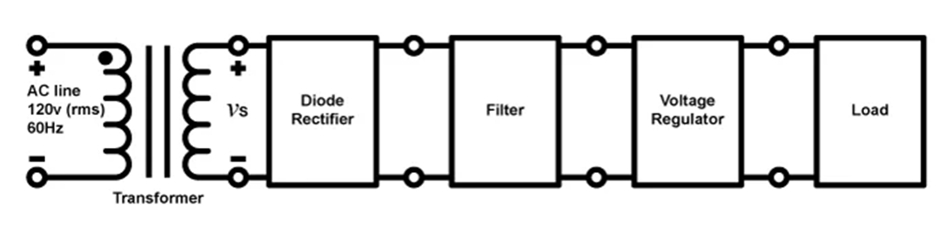
DC power supply
Fig.1 Schematic diagram of a DC power supply

Slide 4
Classification of Rectifiers
Half – Wave Rectifier
Full Wave Rectifier
Center-Tapped Full Wave Rectifier Bridge Rectifier

Slide 5
Half Wave Rectifier
A half wave rectifier allows one half-cycle of an AC voltage waveform to pass, blocking the other half-cycle. Half-wave rectifiers are used to convert AC voltage to pulsating voltage, and require a single diode to construct
Fig.1 Half-wave rectifier.
labelll
Fig.2 Conduction region (0 to T/2).

Slide 6
Half-wave rectifier
Fig.3 Conduction region ( T/2 to T)
Fig.4 Half wa30e rectified signal.

Slide 7
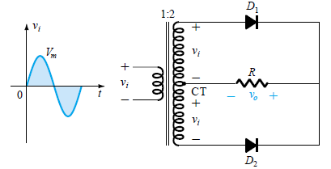
Center tapped Full Wave Rectifier
A full-wave rectifier converts an ac voltage into a pulsating dc voltage using both half cycles of the applied ac voltage.
A full-wave rectifier appears in Fig. 5 with two diodes but requiring a center-tapped (CT) transformer to establish the input signal across each section of the secondary of the transformer. The diodes feed a common load R with the help of a center-tap transformer.
Fig.5 Center-tapped transformer full-wave rectifier.

Slide 8
Center tapped Full Wave Rectifier
During the positive portion of Vi applied to the primary of the transformer, the network will appear as shown in Fig. 6
D1 - Forward biased- short-circuit
D2 – Reverse biased- open-circuit
The output voltage appears as shown in Fig.6
Fig 6 Network conditions for the positive region of vi.

Slide 9
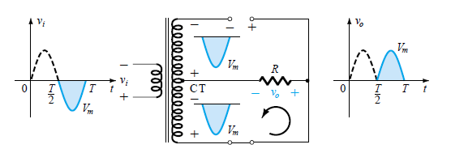
Center tapped Full Wave Rectifier
During the negative portion of the input the network appears as shown in Fig.7
D1 – Reverse biased- open-circuit
D2 - Forward biased- short-circuit
Fig 7 Network conditions for the negative region of vi.

Slide 10
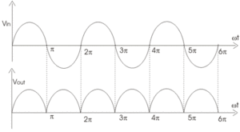
Center tapped Full Wave Rectifier
Fig. 8 Input and output wave forms

Slide 11
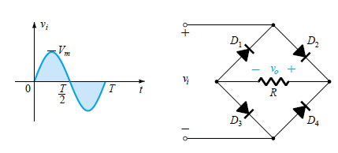
Bridge Rectifier
This type of full wave rectifier uses four diodes connected in a bridge configuration to produce the desired output.
The main advantage of this bridge circuit is that it does not require a special centre tapped transformer, thereby reducing its size and cost. Four diodes labeled D₁ to D₄ are arranged as shown in Fig 9 with only two diodes conducting current during each half cycle
Fig 9. Full Wave Bridge Rectifier

Slide 12
Bridge Rectifier
During the positive half cycle of the supply, diodes D2 and D3conduct in series while diodes D1 and D4 are reverse biased and the current flows through the load as shown below
Fig.10 Conduction path for the positive region of vi.

Slide 13
Bridge Rectifier
During the negative half cycle of the supply, diodes D1 and D4 conduct in series but diodes D2 and D 3 switch “OFF” as they are reverse biased.
The current flowing through the load is the same direction as before.
Fig. 11 Conduction path for the negative region of vi

Slide 14
Bridge Rectifier
Over one full cycle the input and output voltages will appear
as shown in Fig.12
Fig.12 Input and output waveforms for a full-wave rectifier
.

Slide 15


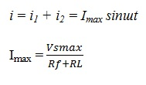
Analysis of Full-Wave Rectifier
Peak Current
The value of peak current (I_{max}) can be derived with the help of instantaneous value of applied voltage and the resistance of the diodes. The value of instantaneous voltage applied to the rectifier circuit can be given as:-
Let’s assume the forward resistance - Rf , load resistor R_{L} then the current flowing through the load resistor can be given as:-
the total current i can be obtained by the sum of i₁ and i₂ for the whole cycle.

Slide 16
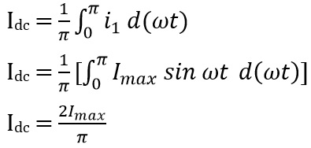

Analysis of Full-Wave Rectifier
Output Current
The current through the load is the same for both the cycles of the ac signal thus, the dc output current can be given as
DC output voltage
The average dc voltage is given as

Slide 17
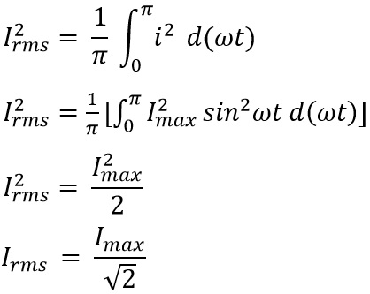
Analysis of Full-Wave Rectifier
RMS Current
The rms current through the load R_{L} is given as

Slide 18

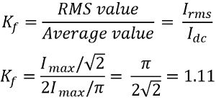
Analysis of Full-Wave Rectifier
RMS Voltage
The rms value of a voltage across the load is given as
Form factor
The form factor is the ratio of rms value to the dc output value of current. It is given as

Slide 19
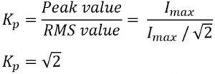


Analysis of Full-Wave Rectifier
Peak factor
It is the ratio of the peak value of current to the rms value of current
Ripple factor

Slide 20


Analysis of Full-Wave Rectifier
The peak inverse voltage (PIV) of the diode is the peak value of the voltage that a diode can withstand when it is reversed biased .The peak inverse voltage of diode in center tapped full wave rectifier is 2 Vsmax and Bridge rectifier is Vsmax.
Rectification Efficiency: The rectification efficiency of full wave rectifier can be obtained by the ratio of dc power delivered to load and ac power present in the output
For bridge rectifier,

Slide 21
Advantages of Full Wave Rectifiers
Advantages of Full Wave Rectifiers
The rectification efficiency of full wave rectifier is much higher than that of half wave rectifier. It is approximately double to that of half wave rectifier i.e. it is about 81%.
The filtering circuit required in full wave rectifier is simple because ripple factor in the case of full wave rectifier is very low as compared to that of half wave rectifier. The value of ripple factor in full wave rectifier is 0.482 while in half wave rectifier it is about 1.21.
The output voltage and output power obtained in full wave rectifiers are much more than that of full wave rectifiers.
Disadvantages of Full Wave Rectifiers
The full wave rectifiers need more circuit elements than half wave rectifier which makes it costlier

Slide 22
Analysis of Half Wave Rectifier---Self study

Slide 23
Thank you

